Slide 1

Scala Spray Akka RESTful application
by Marta Doberschuetz

Slide 2

Project goals
to get familiar with Scala programming language
to get familiar with web service concept and a broad range of technologies
to get familiar with Actor paradigm

Slide 3


The project
is not about the language
it is about the concepts
The technologies:
REST Akka
Spray Slick
Curl Play!
Heroku
Notes:
So I am not an expert in Scala or any of the technologies, I simply got familiar with its concepts.

Slide 4

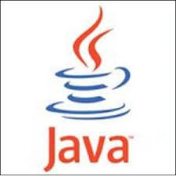

programs resemble
programs and they can seamlessly interact with code written in Java
- Scala shares most of the operators, data types, and control structures with Java and C#
Scala can interact with main platforms: Java and C#
Example1

Slide 5
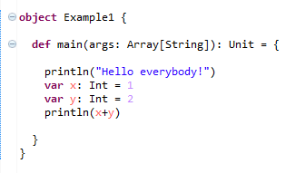
Example1.scala
Notes:
Java’s println method
Int same as int in Java, but capital letter
The difference is how you define variables in Scala x: Int instead of int x
def main starts a method definition – Scala’s syntax is more regular – all definitions start with a keyword
return type is Unit and not void like in Scala and is written after the function definition
Scala has class and object definitions
An object defines a class with a single instance – this is sometimes called a singleton object

Slide 6
OO and functional
Scala uses a pure object-oriented model:
every value is an object and
every operation is an invocation of a method
Scala is a functional language:
every function is a value
so we can pass a function as a parameter into another function
or return them as a result
Example2 & Example3
Notes:
Java is not a pure object-oriented language as it has primitive data types

Slide 7
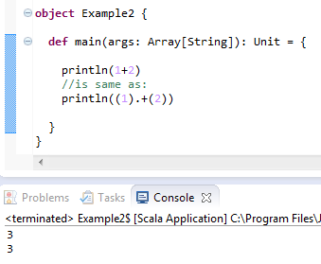
Example2.scala
Notes:
- because u invoke a + method on object which value is 1 and u pass a parameter 2
- remember - everything is an object in Scala

Slide 8
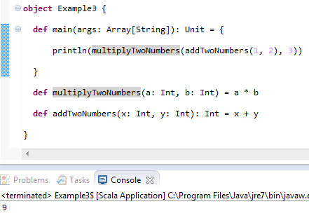
Example3.scala
Notes:
- CORRECT THIS EXAMPLE!!!

Slide 9
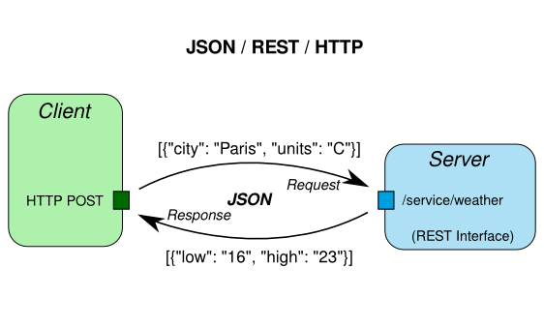
RESTful web service
Notes:
SOAP is a protocol specification for exchanging structured information in the implementation of Web Services
and REST is an architectural style
The idea for the project was to create a RESTful web service that would be hosted on a server (locally or on Heroku).
The service provides basic CRUD operations and a withdraw() and deposit() functions.
We can send a HTTP request in a JSON format and get a response back also in a JSON format.

Slide 10
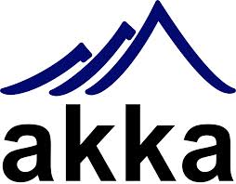

toolkit that allows to create concurrent applications
no race conditions or deadlocks
thread safety
Akka uses Actors
Notes:
Main problem with Java’s concurrency is that when running multiple threads the programmer has to decide what locks to put when on what data
It leads to race conditions - a situation where two different threads access the same data and update the value of that data without locking
It leads to deadlocks – when one threads is waiting for the other to give access to the data, they can be waiting forever…

Slide 11
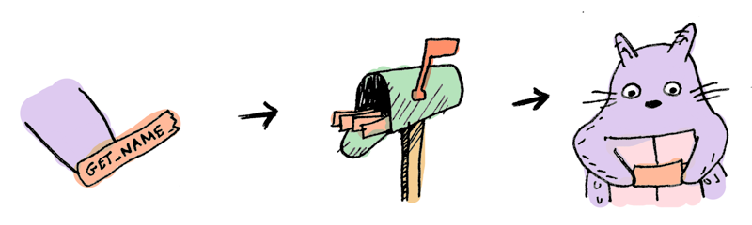
Actor paradigm
messages
mailboxes
Example5.scala
Notes:
An Actor is a thread-like entity that has a mailbox for receiving messages
the actor waits for a message to arrive to its mailbox
- concurrency is message-based and asynchronous
no mutable data is shared
In computer programming, asynchronous events are those occurring independently of the main program flow. Asynchronous actions are actions executed in a non-blocking scheme, allowing the main program flow to continue processing.

Slide 12
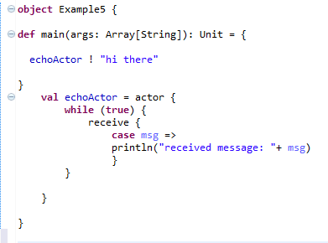
Example5.scala
Notes:
- Actors send messages to each other by using the “!” method
In the example above the actor receives a message by calling “receive”
- When an actor sends a message, it does not block, and when an actor receives a message, it is not interrupted.
The sent message waits in the receiving actor’s mailbox until the actor calls receive.
Note of “case” keyword, receive could have a few “case” statements.
-An actor will only process messages matching one of the cases.
- In my application I have a RestServiceActor.scala

Slide 13

Building the application
build.sbt
- specifies application name, target version of Scala
- defines dependencies (libraries like Akka, Spray, Slick)
project/plugins.sbt
- example: sbt-idea plugin allows to build IntelliJ IDEA project files
Notes:
Start with build configuration files
SBT is simple build tool for Scala
- Project build definition can be extended by using plugins

Slide 14


src/main/resources/application.conf
- defines application configuration settings grouped into service host/port and database configuration entry
- retrieved in Configuration.scala trait
Customer.scala
- defines Customer entity
- defines a Table object Customers for MySQL table customers
- we use to work with MySQL
Notes:
Customer entity has an id, firstName, lastName, accountBalance, birthday
All requiered configuration settings are stored in Configuration.scala trait and retrieved from application.conf file at application startup
Slick is a Functional Relational Mapping for Scala that provides a way of working with Scala’s relational databases

Slide 15

CustomerDAO.scala
specifies how to connect to the database
creates table customers
defines several other methods responsible for interaction with the database: create, update, delete, get and withdraw, deposit
RestServiceActor.scala
- defines the REST/HTTP layer responsible for handling HTTP requests
- built with framework
- REST service is running inside an Akka actor
Notes:
- DAL – data access layer
get = retrieve by id
Spray framework is used for building REST/HTTP-based integration layer which is responsible for serving HTTP requests.
But service logic (with a Spray route structure) is implemented separately. This fact allows us to test its logic independently from an actor behavior.

Slide 16

Running the application locally
sbt run command
call to it with cURL first
data is sent in JSON format
note the HTTP code status response
call to it with
Notes:
command-line tool for transferring data using various protocols.
“-v”
“-X”
"curl http://example.com" it will use GET. If you use -d or -F curl will use POST, -I will cause a HEAD and -T will make it a PUT.
you can override those request methods by specifying -X [WHATEVER]
“-H”
- To make a simple HTTP POST with text/xml as content-type, do something like:
curl -d "datatopost" -H "Content-Type: text/xml" [URL]

Slide 17


Deploying the application to
sample Web.scala Scala application
define your dependencies, build properties, processes with Procfile
use to push your files to Heroku

